Slide 1



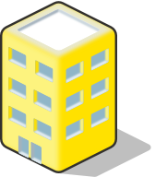










House Type | Level 1 | Level 2 (upgrade fee) | Level 3 (upgrade fee)
Residential Building |  |  | Lack picture
Bank
Supermarket |  |  | Lack picture
Park changed to Hospital
Farm
Construction Site |  | Lack picture | Lack picture

Slide 2
House Type | Level 1 | 占tile数量 | Tilecell坐标
Residential Building |  | 1 | (x,y)
Bank |  | 4 | (x,y) (x+1,y) (x,y+1) (x+1,y+1)
Supermarket |  | 2 | (x,y) (x+1,y)
Park changed to Hospital |  | 2 | (x,y) (x+1,y) (x,y+1) (x+1,y+1)
Farm |  | 2 | (x,y) (x+1,y)
Construction Site |  | 2 | (x,y) (x+1,y)

